Slide 1
Cloud Native Architecture
Introduction
Péter Megyesi, Dávid Szabó, Attila Papp

Slide 2
Lab 1
Introduction to the Azure Cloud

Slide 3

What is Microsoft Azure?
Microsoft’s public cloud computing platform
Over 200 individual product and services
Build, run and manage application on Microsoft’s global infrastructure
  Infrastructure as a Service (IaaS)
  Platform as a Service (PaaS)
  Software as a Service (SaaS)
Supplement or replace existing on-premises applications

Slide 4
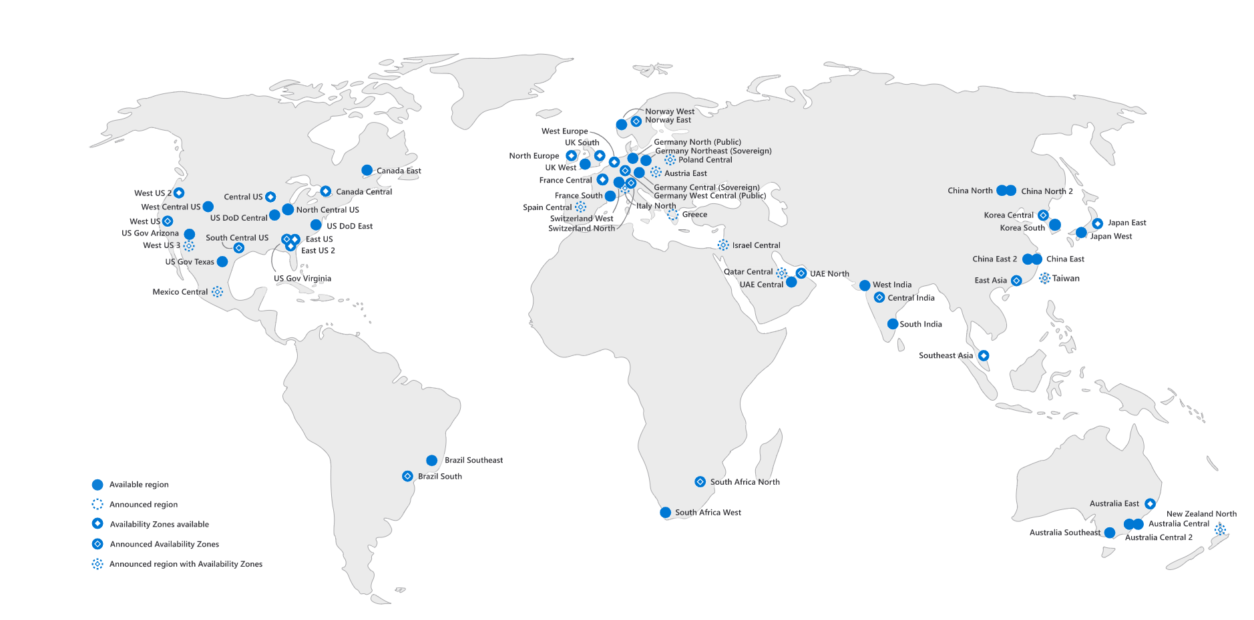
Azure Global Infrastructure

Slide 5
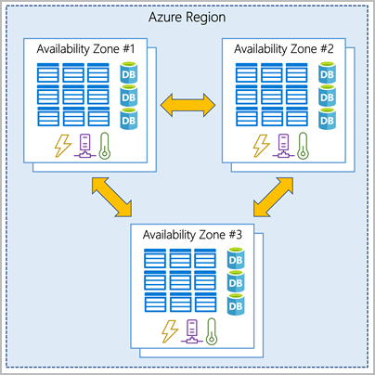
Azure Availability Zones
Physically separate datacenters within an Azure region
  Datacenters equipped with independent power, cooling, and networking
Ensure your services & data are redundant (in case of failure)
Minimum three zones within a single region
Connected through high-speed
Availability zones are primarily for:
  VMs, managed disks, load balancers, SQL databases
Not every region has support for availability zones

Slide 6
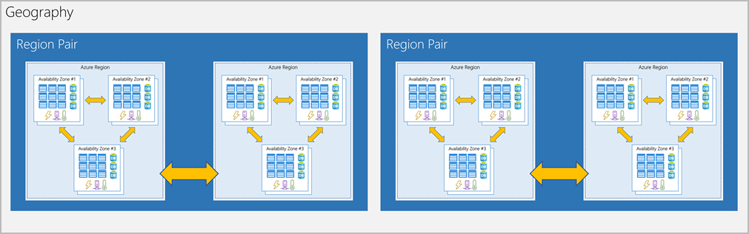
Azure Region Pairs
Large disaster → outage big enough to affect even two datacenters
Region is always paired with another region:
  Within the same geography (such as US, Europe, or Asia)
  At least 300 miles away
Provide reliable services and data redundancy

Slide 7
How to Access Azure?
Graphical web interface
  Azure Portal
CLI tools
  Azure CLI: Bash / POSIX compatible (usually used under Linux)
  Azure PowerShell (usually used by Windows admins)
REST API
  SKD available in multiple languages
  .NET, Node.js, Java, PHP, Python, Ruby, Go

Slide 8
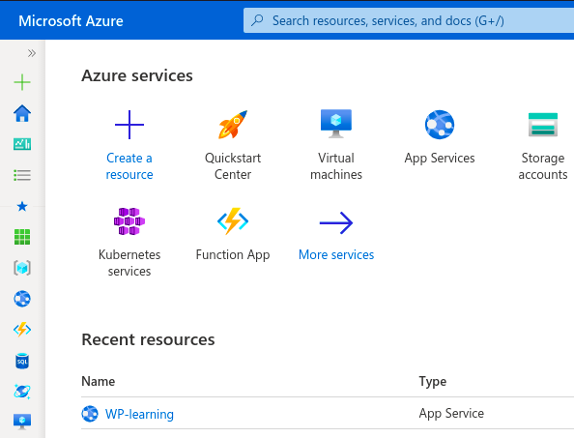
Azure Portal
Web-based, unified console (alternative to command-line tools)
  Build, manage, and monitor everything
  Create custom dashboards
Designed for resiliency and continuous availability
  Individual datacenter failures and avoids network slowdowns
  Updates continuously and requires no downtime for maintenance

Slide 9
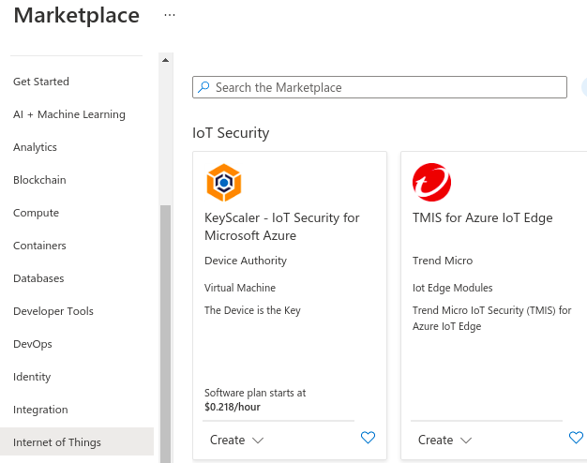
Azure Marketplace
Softwares certified and optimized to run on Azure
Find solutions you want
  from open source container platforms to threat
  detection to blockchain
Provision end-to-end solutions
quickly and reliably
Use Test drives to try out pre-configured
applications

Slide 10
Azure Subscriptions
Using Azure requires a subscription
Subscription provides you access to Azure products and services
  authenticate and authorize
Subscription is a logical unit of Azure services that links to an Azure account
An account can have multiple subscriptions

Slide 11





Azure subscriptions
Billing unit that aggregates all costs of underlying resources
Contain resoure groups (logical containers) and their associated resources
Scoping level for governance and security
Subscription
Resource Groups

Slide 12


Azure subscriptions
Reflects the organization billing hierarchy
  Transparent way of billing for groups
Types:
  Free Trial, Azure for Students, Pay-As-You-Go, …
Azure Active Directory
Billing Admin
Marketing
Engineering
Resource Groups
Resource Groups

Slide 13
Azure subscriptions – naming/grouping conventions
By environment:
  Prod/Dev/Staging
By department/team:
  Marketing/Engineering
By region:
  Europe/Asia
Azure Active Directory
Billing Admin
Marketing
Engineering
Resource Groups
Resource Groups

Slide 14

Management groups
Organize and manage subscriptions by logically grouping them into management groups.
  Organizational hirerachy
  Another scope for enforcing governance and compliance
Parent-child relationship:
  Root mgmt group is the top level
  Mgmg groups and subscriptions can have a single parent
  Supports six level of hierarchy
Compliance support:
  Azure Policies
  Azure role-based access control (RBAC)

Slide 15
Management groups
Organize and manage subscriptions by logically grouping them into management groups.
  Organizational hirerachy
  Another scope for enforcing governance and compliance
Parent-child relationship:
  Root mgmt group is the top level
  Mgmg groups and subscriptions can have a single parent
  Supports six level of hierarchy
Compliance support:
  Azure Policies
  Azure role-based access control (RBAC)
Root
EA
Marketing
IT
Trial
Trial
IT

Slide 16
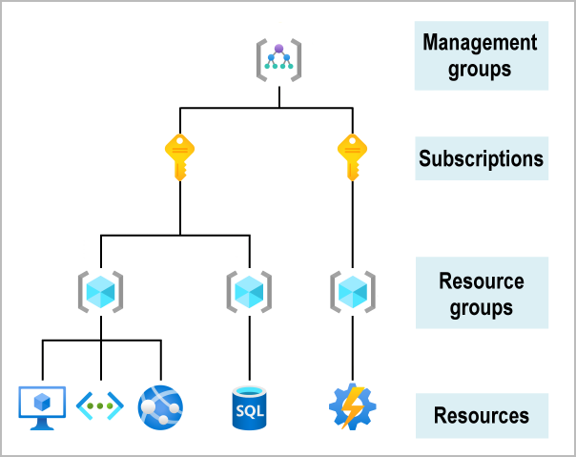
Azure subscriptions, management groups, and resources
Manage access, policy, and compliance for multiple subscriptions. Subscriptions automatically inherit the conditions applied to the management group.
Groups together user accounts and the resources that have been created by those user accounts. For each subscription, there are limits or quotas on the amount of resources that you can create and use.
Resources are combined into resource groups, which act as a logical container.
Resources are instances of services that you create.
eg: virtual machines, storage or SQL databases

Slide 17
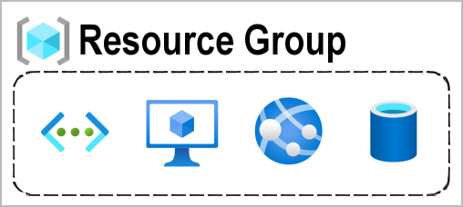
Azure resource group
Resource: manageable item
  Eg: VMs, storage accounts, web apps, databases, virtual networks
Resource group: Container that holds related resources for an Azure solution
Rules:
  All resources must be in a resource group
  A resource can only be a member of a single resource group
  Resource groups can't be nested
  Need a resource group before any resource can be provisioned
Life cycle
  Delete a resource group → all resources contained also deleted
  Useful: Create and delete experiment / dev resources
Scope for role-based access control permissions

Slide 18


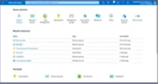
Azure Resource Manager
ARM is the orchestration layer for managing resoureces
Uses REST API endpoints
  Azure Portal
  Azure Powershell
  Azure CLI
Azure Resource Manager
Azure Resource Manager
Subscription
Resource Groups

Slide 19
Azure Resource Manager
ARM is the orchestration layer for managing resoureces
Uses REST API endpoints
  Azure Portal
  Azure Powershell
  Azure CLI
More precisely, ARM calls Azure Resource Providers:
  Each provider manages the resources themselves
What prevents someone to manage resources in a subscription that does not belong to them?
  Active Directory - Tenant
Azure Resource Manager
Azure Resource Manager
Azure Resource Providers
Subscription
Resource Groups
Tenant B
Trust relationship
Tenant A

Slide 20
Azure Resource Manager - Overview
The deployment and management service for Azure
Provides a management layer that enables you to create, update, and delete resources
Receives the user request
→ authenticates and authorizes
→ sends the request to the Azure service
(takes the requested action)
Requests are handled through the same API
→ Same capabilities in Azure Portal, PowerShell, Azure CLI, REST APIs, and client SDKs

Slide 21

Azure Resource Manager – templates
ARM templates:
  Infrastructure as Code (IaC)
  Deploy environments quickly
  Repeatable deployments
via CLI or UI
Azure Resource Manager
Azure Resource Manager
Azure Resource Providers
{
"$schema": "https://schema.management.azure.com/schemas/2019-04-01/deploymentTemplate.json#",
"contentVersion": "",
"apiProfile": "",
"parameters": { },
"variables": { },
"functions": [ ],
"resources": [ ],
"outputs": { }
}
Subscription
Resource Groups

Slide 22
Billing (very) basics
Pay only for what you use
  Compute resources: CPU and memory allocated
  Storage: per GB cost
  Networking: pay for every outgoing GB
  Other (usually SaaS): per user, per API call, etc.
Many services can help you with cost management
  Analysis: fine grade breakdown on how costs are structured, even with BI support
  Management: set up budget and restrictions
  Optimization: plan for future services, optimize used resources

Slide 23
Billing (very) basics
Azure Migrate: allows for digital estate inventory, limited rationalization, and cost calculations in one tool.
Total cost of ownership (TCO) calculator: estimate the cost savings you can realize by migrating your application workloads to Azure.
Azure pricing calculator: Estimate your expected monthly bill by using our pricing calculator.
Azure Cost Management + Billing:
Cost management solution that helps you use and manage Azure and other cloud resources effectively.
Collect cloud usage and billing data through application program interfaces (APIs) from Azure, Amazon Web Services, and Google Cloud Platform.
Gain full visibility into resource consumption and costs across cloud platforms in a single, unified view.
Detect spending anomalies and usage inefficiencies.
Use historical data to improve your forecasting accuracy for cloud usage and expenditures.
Notes:
https://docs.microsoft.com/en-us/azure/cloud-adoption-framework/digital-estate/calculate

